Slide 1
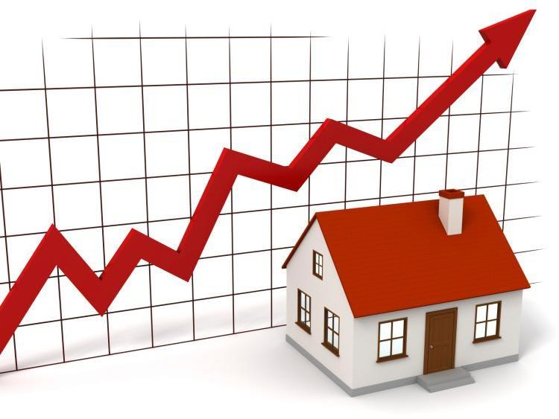
HOUSE PRICE PREDICTION SYSTEM

Slide 2
Presented BY
Pooja Ashual
Nayana Narayanan
Prajith Prakash

Slide 3
Contents
Introduction
Literature Review
Product Backlog
Data Processing
Model Selection
Conclusion
References

Slide 4
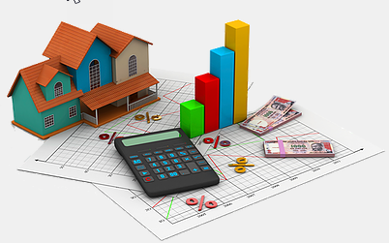
INTRODUCTION
The goal of this project is to develop a machine learning model that accurately predicts house prices based on various property features such as location, size, and amenities.
Predicting house prices is critical for buyers, sellers, and real estate agents to make informed decisions, especially in fluctuating housing markets.

Slide 5
LITERATURE REVIEW
Paper 1: House Price Prediction with Statistical Analysis in Support Vector Machine Learning for Regression Estimation“
Authors: Sachin Verma, Suruchi Pandey, and Om Prakash Verma
Objective: The paper focuses on predicting house prices using a combination of statistical analysis and Support Vector Machine (SVM) learning methods.
Key Points:
The authors apply regression techniques within SVM to estimate house prices based on various features such as location, size, and amenities.
They compare the performance of SVM with other machine learning models and statistical methods, demonstrating the effectiveness of SVM for this task.
The study highlights the importance of feature selection and data preprocessing in improving prediction accuracy.

Slide 6
LITERATURE REVIEW
Paper 2: "House Price Prediction using a Machine Learning Model: A Survey of Literature"
Authors: Nor Hamizah Zulkifley, Shuzlina Abdul Rahman, Nor Hasbiah Ubaidullah, Ismail Ibrahim
Objective: The paper reviews various machine learning models used for predicting house prices, with a focus on identifying the most effective models and key predictive attributes.
Key Points:
The authors analyze different machine learning models like Artificial Neural Network (ANN), Support Vector Regression (SVR), and XGBoost, assessing their efficiency in predicting house prices.
They emphasize the importance of locational, structural, and neighborhood attributes in determining house prices.
The study aims to assist stakeholders in the real estate market by highlighting the best models and key attributes for accurate house price prediction.

Slide 7
LITERATURE REVIEW
Paper 1: HOUSE PRICE PREDICTION USING MACHINE LEARNING
Authors:DR .S . LALITHAKUMARI
Objective: To build a model that can predict the price of houses based on various features such as location, size, and amenities.
Key Points:
Linear Regression Algorithm: The system employs a linear regression algorithm, which models the relationship between the selected features (e.g., number of rooms, location) and the house prices by fitting a linear equation to the observed data.
Gradient Descent Optimization: To minimize the cost function (e.g., Mean Squared Error), the algorithm uses gradient descent optimization, iteratively adjusting the model's parameters to improve prediction accuracy.
Regularization Techniques: To prevent overfitting and enhance the generalization of the model, regularization techniques like Lasso (L1) or Ridge (L2) regression may be incorporated, ensuring the model performs well on new, unseen data.

Slide 8
LITERATURE REVIEW
Paper 2:Real Estate Price Prediction Using Machine Learning
Authors:Aswin Sivam Ravikumar
Objective: Provide accurate house prices to save money and time
Key Points:
Linear Regression: A simple yet powerful algorithm that models the relationship between features and the target variable (house price) by fitting a linear equation to the observed data.
Random Forest: An ensemble method that builds multiple decision trees and combines their predictions to improve accuracy and reduce overfitting.
Gradient Boosting: A method that builds an additive model in a forward stage-wise fashion; it optimizes for accuracy by sequentially adding models that correct the errors of previous models. Popular implementations include XGBoost and LightGBM.

Slide 9
Product backlog
ID | User Story | Task Description
1 | As a user, I want a system that predicts house prices accurately | Research various machine learning models used for house price prediction (literature review).
2 | As a user, I want data that is clean and ready for analysis. | Collect a relevant dataset (e.g., from Kaggle, public repositories).
3 | As a user, I want the data to be pre-processed for model training. | Clean and preprocess the dataset (handling missing data, normalizing features, etc.).
4 | As a data scientist, I want to identify features that affect pricing. | Perform exploratory data analysis (EDA) to identify key features impacting house prices.
5 | As a user, I want to handle outliers in the dataset effectively. | Detect and treat outliers in the dataset.
6 | As a data scientist, I want to scale the features for better model performance. | Apply feature scaling techniques (e.g., normalization or standardization).

Slide 10
Product backlog
ID | User Story | Task Description
7 | As a data scientist, I want to encode categorical variables. | Apply encoding techniques (One-hot, Label Encoding) to categorical features.
8 | As a user, I want to select the most relevant features for the model. | Perform feature selection (using correlation matrices, statistical methods, etc.).
9 | As a user, I want the system to provide an initial baseline prediction. | Train a simple baseline model (e.g., Linear Regression) for house price prediction.
10 | As a user, I want to evaluate model performance effectively | Define evaluation metrics (e.g., MAE, RMSE, R-squared).
11 | As a data scientist, I want to compare different algorithms | Train and compare multiple models (e.g., Decision Tree, Random Forest, SVR).
12 | As a user, I want to visualize model performance for better understanding. | Visualize results using plots (e.g., error distributions, feature importance).
13 | As a user, I want to improve model accuracy. | Tune hyperparameters using techniques like Grid Search or Random Search.

Slide 11
Product backlog
ID | User Story | Task Description
14 | As a data scientist, I want to avoid overfitting for a more general model. | Implement cross-validation and/or regularization techniques.
15 | As a user, I want to ensure the final model performs optimally. | Train the final model on the entire dataset.
16 | As a data scientist, I want to assess the model on unseen data. | Evaluate the final model on a test dataset.
17 | As a user, I want the model to be ready for deployment. | Save the trained model in a format suitable for deployment (e.g., pickle file).
18 | As a user, I want to document the findings and approach. | Write detailed documentation explaining the model, its features, and performance.
19 | As a researcher, I want to review literature for the final report. | Perform a literature review for related works and methodologies on house price prediction models
20 | As a user, I want to present the results clearly. | Prepare a final presentation and report summarizing the project's outcomes and results

Slide 12
Burndown chart

Slide 13
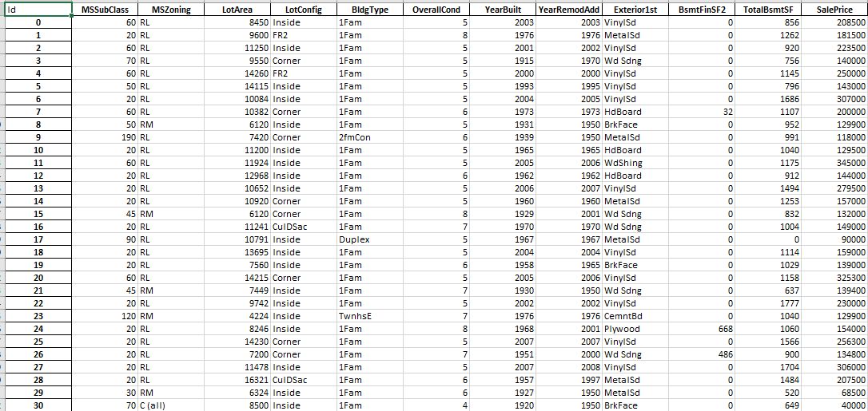
Data SET

Slide 14
Data SET
Dataset Source:
The data was sourced from Kaggle
contains 2,919 rows and 13 columns.
Features and Attributes
Numeric attributes: `Id`, `MSSubClass`, `LotArea`, `OverallCond`, `YearBuilt`, `YearRemodAdd`, `BsmtFinSF2`, `TotalBsmtSF`,`SalePrice`.
Categorical attributes: `MSZoning`, `LotConfig`, `BldgType`, `Exterior1st`.

Slide 15
Data Preprocessing
Convert categorical data to numeric values for model compatibility.
Removed or filled missing data to ensure data quality.
Visualized feature relationships to guide model development.

Slide 16
Categorical Data Conversion
Converting Categorical Data to Numeric
Overview: Machine learning models require numeric data.
Action Taken: Converted categorical features like `MSZoning`, `BldgType`, etc., into numeric values using One-Hot Encoding.
Impact: This conversion allows the model to process and learn from the data effectively, ensuring better accuracy and compatibility.

Slide 17
Handling missing values
Addressing Missing Data
Overview: Missing data can lead to inaccuracies in model predictions.
Action Taken: Filled missing values in the `SalePrice` column with the mean value and removed rows with remaining missing values.
impact: Ensured that the dataset is clean and reliable, which is crucial for training an accurate machine learning model.

Slide 18
Data Visualization
Visualization of Data Relationship
Overview: Understanding feature relationships is key to effective model development.
Action Taken: Used heatmaps and bar plots to visualize correlations and distributions of features.
Impact: Identified key features that significantly influence house prices, guiding the model development and improving prediction accuracy.

Slide 19
Model selection
Support Vector Regressor (SVR)
Purpose
Handles non-linear relationships using kernel functions.
Advantage
Effective for high-dimensional data.
Random Forest Regressor (RFR)
Purpose
Uses an ensemble of decision trees for improved accuracy and reduced overfitting.
Advantage
Robust to diverse and complex datasets.

Slide 20
Model selection
Linear Regression (LR)
Purpose
Models linear relationships between features and target variable.
Advantage
Simple and interpretable, provides clear feature impact insights.

Slide 21
Conclusion
We aim to utilize advanced machine learning algorithms, such as Random Forest and SVM, to capture the complex factors that influence property values.
For house price prediction, Random Forest Regression generally offers superior performance .
By focusing on key features like location, size, and market trends, our goal is to create a robust and accurate tool that can assist stakeholders in making informed real estate decisions.

Slide 22
References
https://scholar.google.com/
https://www.geeksforgeeks.org/
https://www.kaggle.com/

Slide 23
THANK YOU

